Slide 1

Microsoft Excel
Clinical Specialization (Intermediate)

Slide 2
Goals:
Have fun and learn something.
Demonstrate Proficiency in Excel operations
Apply Advanced Excel functions to highlight, sort, and filter data.
Utilize Excel Formulas and Functions to determine future dates.

Slide 3
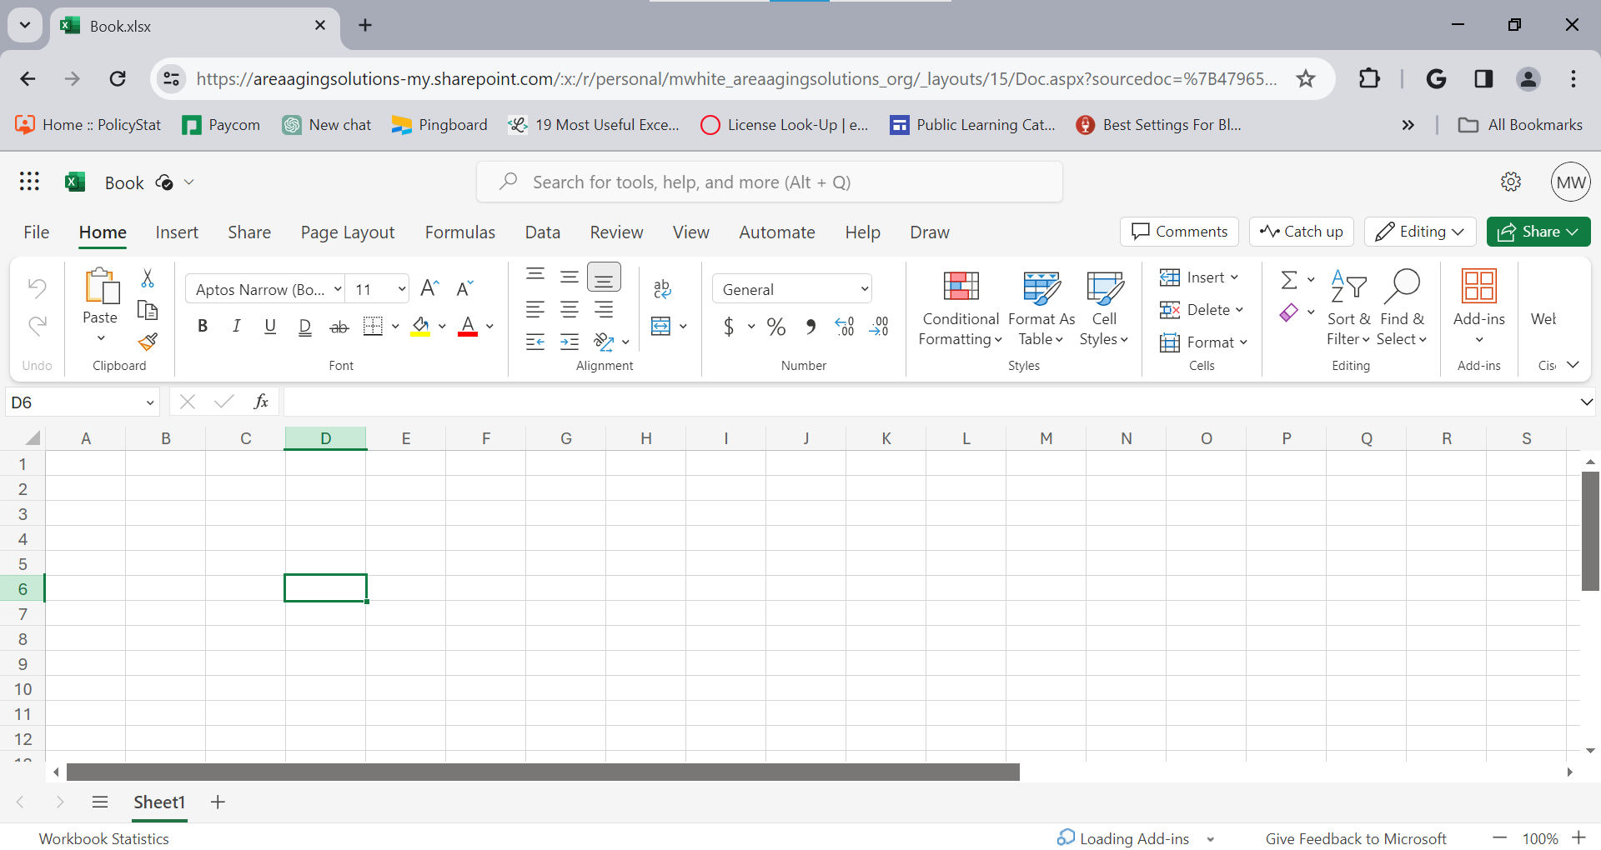
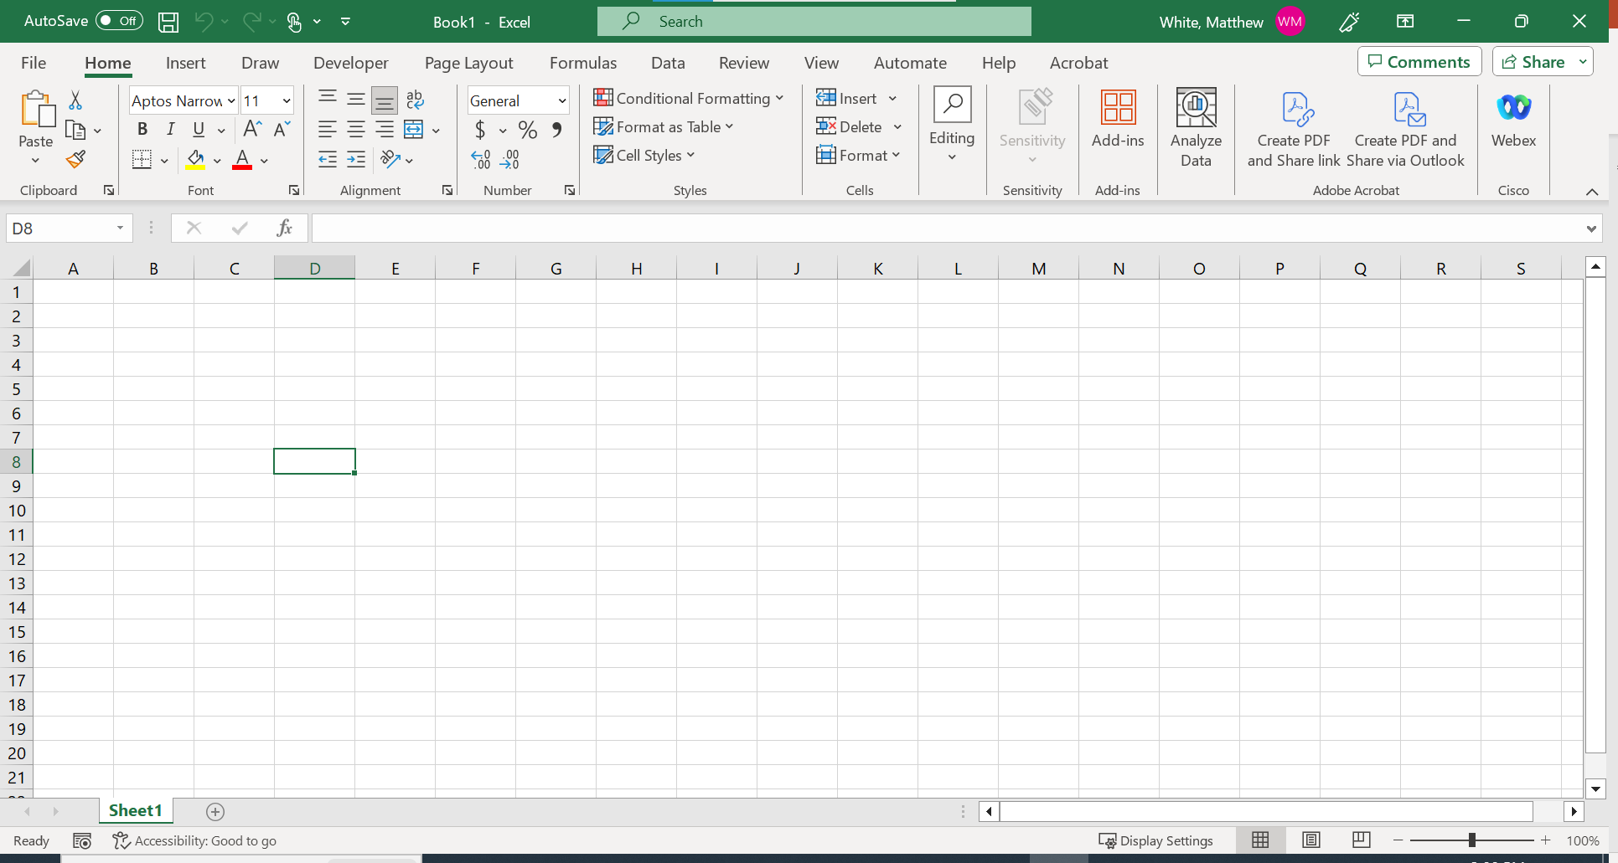
Microsoft Excel
There are two separate versions of Excel that you have access to.
Excel Online (Browser)
Desktop Program

Slide 4
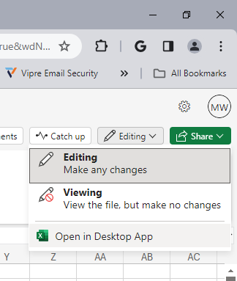
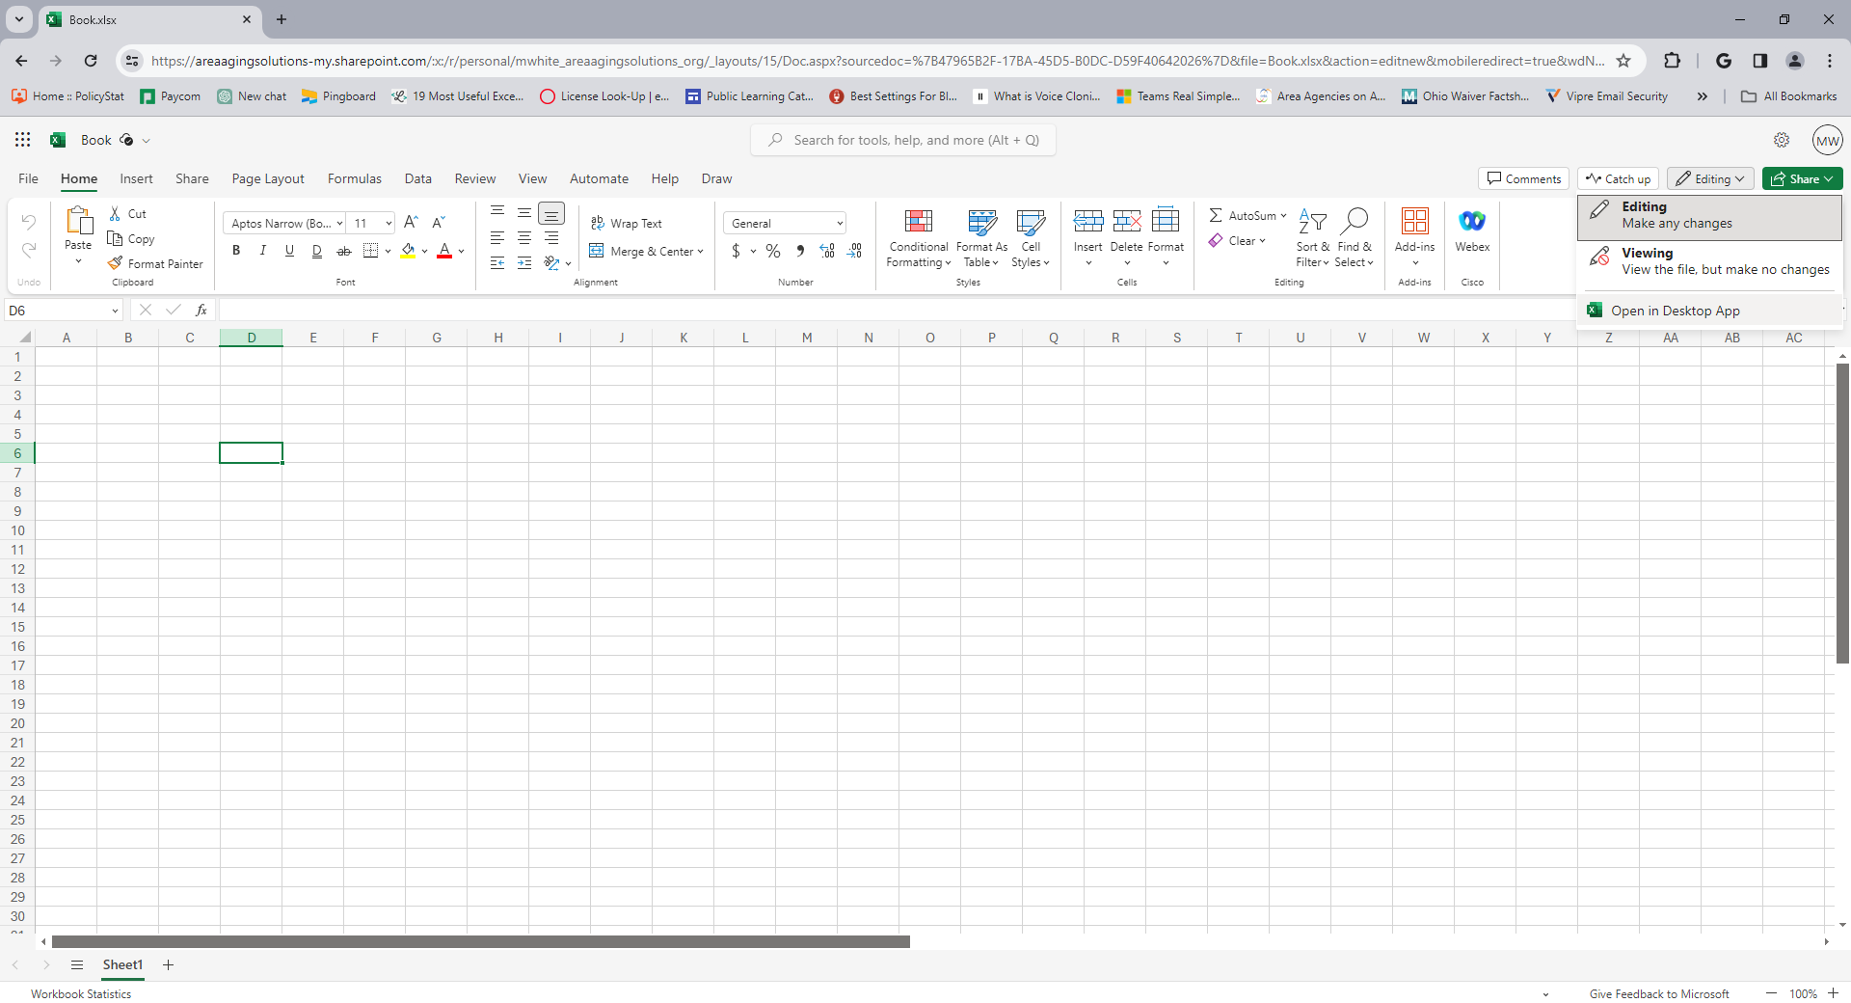
Microsoft Excel
For this training, we will utilize the Desktop program

Slide 5
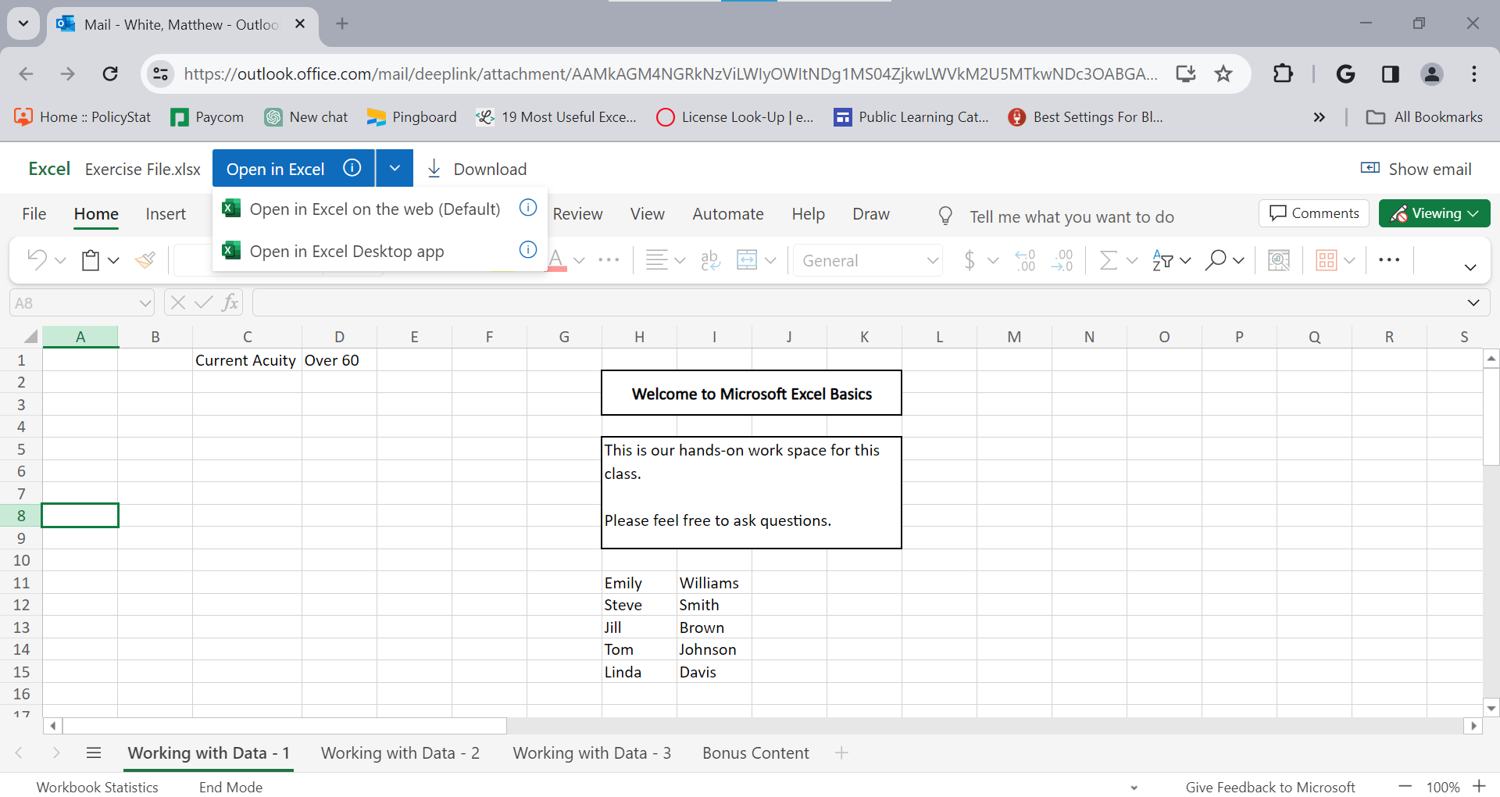
Microsoft Excel
For this training, we will utilize the Desktop program

Slide 6
Microsoft Excel
Has everyone received the Clinical Specialization Excel Workbook?

